Slide 1

Pune Vidyarthi Griha’s College of Engineering & SSD IOM, Nashik
Project on
“Face Mask Detection System Using AI”
Presented by
Group Members :
Mr. Tejas Bansode
Mr. Abhijit Shermale
Mr. Darshan Shinde
Mr. Suraj Pawar
Guided by
Prof. M.T.Jagtap
GROUP ID - 11

Slide 2
Contents
Problem Definition
System Architecture
Modules
Algorithms
Results Screen Shot
Application
Future Scope
Conclusion
References

Slide 3
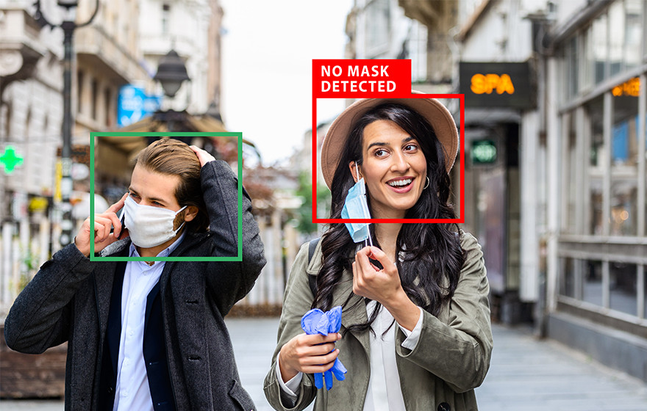
Problem Statement
Wearing a mask in public settings is an effective way to keep the communities safe as a response to the covid-19 pandemic, We open-sourced a face mask detection application that uses AI detect if people are wearing masks or not. Focused on making our face mask detector ready for real-world applications, such as CCTV cameras, where faces are small, blurry, and far from the camera.

Slide 4
System Architecture
Camera
With mask
Without mask
With Mask
Without Mask
Employee Data
Send Email
Input
Hidden
Output
Fig. 1. Proposed System Architecture

Slide 5
Modules
1. Mask Detection
2. Face Detection
3.Email Alert
- Our objective is to train a specialised CNN model to detect whether or not someone is wearing a mask.
- Face detection applications use algorithms and ML to find human faces within larger images
- When system will find the person is not wearing a mask then email is sent to that person mail

Slide 6
Algorithm
CNN (Convolutional Neural Network):
Convolution Operation
ReLU Layer
Pooling
Flattening
Full Connection

Slide 7
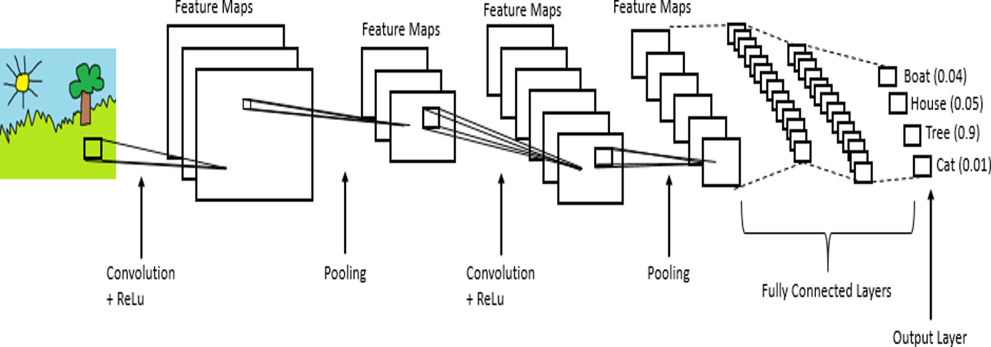
Basic Working of CNN

Slide 8
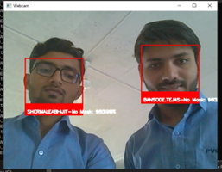
Result Screenshot :-

Slide 9
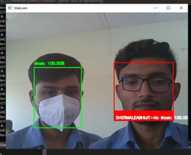

Slide 10
Applications
School/Colleges
Company
Hospitals
Bank
Bus Station
Railway Station
Airport

Slide 11
Future Scope
Finally, the work opens interesting future directions for researchers. Firstly, the proposed technique can be integrated into any high-resolution video surveillance devices and not limited to mask detection only. Secondly, the model can be extended to detect facial landmarks with a facemask for biometric purposes.

Slide 12
Conclusion
With the help of this proposed system, we are able to contribute in public healthcare and welfare. Using basic ML tools and simplified techniques the method has achieved reasonably high accuracy.

Slide 13
References
[1] Rahman, Mohammad Marufur; Manik, Md. Motaleb Hossen; Islam, Md. Milon; Mahmud, Saifuddin; Kim, Jong-Hoon (2020). [IEEE 2020 IEEE International IOT, Electronics and Mechatronics Conference (IEMTRONICS) - Vancouver, BC, Canada (2020.9.9-2020.9.12)] 2020 IEEE International IOT, Electronics and Mechatronics Conference (IEMTRONICS) - An Automated System to Limit COVID-19 Using Facial Mask Detection in Smart City Network. , (), 1– 5. doi:10.1109/IEMTRONICS51293.2020.9216386
[2] Sakshi, S., Gupta, A. K., Singh Yadav, S., & Kumar, U. (2021). Face Mask Detection System using CNN. 2021 International Conference on Advance Computing and Innovative Technologies in Engineering (ICACITE). doi:10.1109/icacite51222.2021.940
[3] Islam, M. S., Haque Moon, E., Shaikat, M. A., & Jahangir Alam, M. (2020). A Novel Approach to Detect Face Mask using CNN. 2020 3rd International Conference on Intelligent Sustainable Systems (ICISS). doi:10.1109/iciss49785.2020.9315
[4] Suresh, K., Palangappa, M., & Bhuvan, S. (2021). Face Mask Detection by using Optimistic Convolutional Neural Network. 2021 6th International Conference on Inventive Computation Technologies (ICICT). doi:10.1109/icict50816.2021.9358

